Slide 1
Week 13: I/O and File Processing
Objectives:
Understand the concepts of file I/O.
Learn how to use standard functions for formatted I/O.

Slide 2
File Processing: Motivation
Problem solving on arrays usually involve large amount of data, and it is impractical to enter the data through the keyboard.
We have used input file redirection < to redirect data from a text file.
This is a feature provided by the operating system.
a.out < 1.in

Slide 3
File Processing: Overview
C provides functions to handle file input/output (I/O).
Typically, file processing requires:
Opening a file (fopen)
Testing if the file is opened successfully
Reading data from or writing data to the file (fscanf, fprintf)
Closing the file (fclose)
All I/O functions are defined in the header file <stdio.h>

Slide 4
Opening a File and File Modes (1/3)
FILE *infile, *outfile;
infile = fopen("demo1.in", "r");
outfile = fopen("demo1.out", "w");
open file "demo1.in" for reading
define FILE pointers
"w" for writing mode
fopen() function opens a file.
It returns a NULL pointer if an error is encountered.
Otherwise, it returns a pointer of FILE * type.
Error can happen, e.g., when you try to open a file for reading, but the file doesn’t exist in the specified directory, or you don’t have permission to open this file.
Notes:
CS1010 Programming Methodology
©The McGraw-Hill Companies, Inc.
4
I found that some students have been using NULL as the null character ('\0'), but their program works. This is incorrect.
The reason the program works is that NULL is defined as 0L in many header files, but there is no rule saying that it must be defined as 0. [Actually it should be (void *) 0]. Since the null character '\0' has an ASCII value of 0, it is a mere coincidence that using NULL works, but this should be discouraged.
Hence when working on strings, students should stick to the null character '\0' instead of NULL. NULL is used where a null pointer is intended.

Slide 5
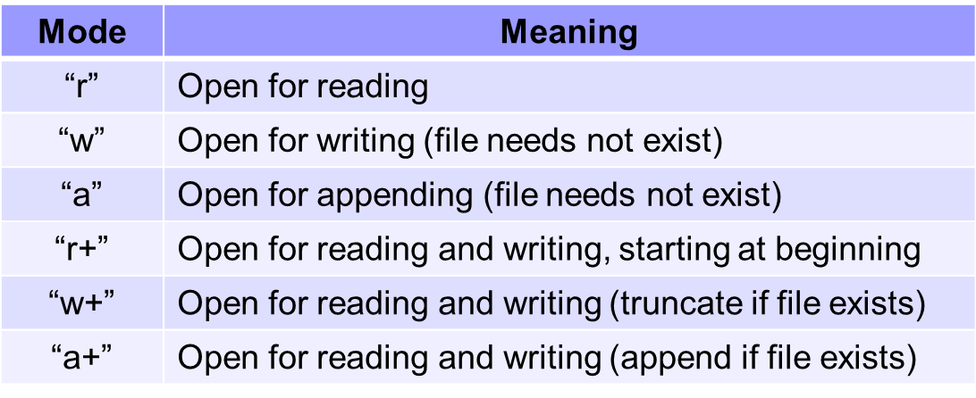
Opening a File and File Modes (2/3)
File modes for text files:
We will focus on "r" and "w" only.
Note that
In "r" mode, file must already exist.
In "w" mode, new data will overwrite existing file data (if any).
Notes:
CS1010 Programming Methodology
©The McGraw-Hill Companies, Inc.
5

Slide 6
Opening a File and File Modes (3/3)
We often use fopen() function with error checking routine
If file is opened successfully, fopen() function returns a pointer pointing to the first data in the file.
If file is failed to be opened, a NULL pointer will be returned.
Week13_Demo1.c
#include <stdio.h>
#include <stdlib.h>
int main(void)
{
FILE *infile;
// process data...
return 0;
}
to use exit()
check whether file is opened successfully
if ( (infile = fopen("demo1.in", "r")) == NULL ) {
printf("Cannot open file demo1.in\n");
exit(1);
}
exit function terminates the program immediately
Notes:
When the program terminates with exit(...), immediate enter echo $? in UNIX to find the exit code the program terminated with. It should show 1 or 2 in this example.
$? in UNIX refers to the exit status of the last executed program/command.

Slide 7
Reading / Writing a File (1/3)
float weight, height;
FILE *fp1, *fp2;
// error checking routine skipped
fp1 = fopen("demo1.in", "r");
fp2 = fopen("demo1.out", "w");
fscanf (fp1, "%f %f", &weight, &height);
fprintf(fp2, "Wt: %f, Ht: %f\n", weight, height);
fscanf read data from a file.
fprintf write data to a file.
The use of fscanf and fprintf is similar to scanf and printf.
except for the additional FILE * pointer argument

Slide 8
Reading / Writing a File (2/3)
Suppose we want to read all data from a file.
If we know the number of data in the file beforehand, we can use a loop to keep reading data one by one.
But what if we are not aware of the total number of the data in the file? (see next page)

Slide 9
Reading / Writing a File (3/3)
fscanf returns EOF if it fails to read any data; otherwise, it returns the number of data that were read and stored.
EOF is a macro (constant) whose value is commonly -1.
Assuming that file contains no error, then a return value of EOF means you have reached the end of the file.
Input file:
10 20 30 40
FILE *fp;
int var;
// open file using pointer fp
while ( fscanf(fp, "%d", &var) != EOF )
{
printf("%d\n", var);
}
10
20
30
40
//while (fscanf(fp, "%d", &val) == 1)
Week13_EOF.c

Slide 10
Closing a File
#include <stdio.h>
int main(void)
{
FILE *infile, *outfile;
infile = fopen("demo1.in", "r");
outfile = fopen("demo1.out", "w");
// error checking routine skipped
// data reading and writing skipped here
fclose(infile);
fclose(outfile);
return 0;
}
close the file stream represented by this pointer variable
It is good practice to close a file after use.
Notes:
CS1010 Programming Methodology
©The McGraw-Hill Companies, Inc.
10

Slide 11

Summary for Today (1/2)
Today’s most important lessons
File processing
I/O on text files
fopen, fclose
I/O functions
Formatted I/O: fprintf, fscanf
Error checking on opening a file and detecting end-of-file (EOF) is essential

Slide 12
Summary for Today (2/2)
#include <stdio.h>
#include <stdlib.h>
int main(void)
{
FILE *infile, *outfile;
int num;
if ((infile = fopen("demo2.in", "r")) == NULL) {
printf("Cannot open file demo2.in\n");
exit(1);
}
if ((outfile = fopen("demo2.out", "w")) == NULL) {
printf("Cannot open file demo2.out\n");
exit(2);
}
while ( fscanf(infile, "%d", &num) != EOF )
fprintf(outfile, "Value read: %d\n", num);
fclose(infile); fclose(outfile);
return 0;
}
define pointers for I/O streams
open files with error checking
read data while detecting end of file
write data to output file
close files after processing
Notes:
CS1010 Programming Methodology

